Slide 1
Breast Cancer Prediction from Digitized image of a Fine Needle Aspirate (FNA) of a Breast Mass Using Deep Neural Network (TensorFlow 2.0)
Springboard Data Science Capstone Project II
Frew Berhe
(MPH/Epidemiology, Data Science Career Track student, May 28 cohort)

Slide 2
Introduction
Breast cancer one of the most common causes of death in women.
Accurate diagnosis of breast cancer is of prime importance.
Fine Needle Aspirate (FNA) of breast tumor
Pathologists require expertise and skill for analysis of FNA sample.
Hence, development of algorithms which rely on digitized image analysis, is of great interest.

Slide 3
Objective
To predict breast cancer as benign or malignant using data set from the digitized image of FNA sample.
We propose to use data and build a DNN model using TensorFlow 2.0
Doctors and pathologists in different Hospitals can use such model

Slide 4
Breast Cancer Wisconsin Diagnostic Data Set
The data set was acquired from the Kaggle Competition
Digitized image of FNA of a breast mass
Originally, 569 observations and 33 columns

Slide 5
Breast Cancer Wisconsin Diagnostic Data Set…cont’d
This data contains information on nuclear morphometry
10 real valued features : Area_mean, perimeter_mean
10 Mean of three Worst values: Area_worst, perimeter_worst
10 Standard Error (se): Area_se, perimeter_se

Slide 6
Data Exploration
The three features that seem most relevant features for our prediction are
'radius_mean’,
'perimeter_mean’, &
'concavity_mean',
Followed by
'area_mean’,
'compactness_mean', and
'texture_mean'.

Slide 7
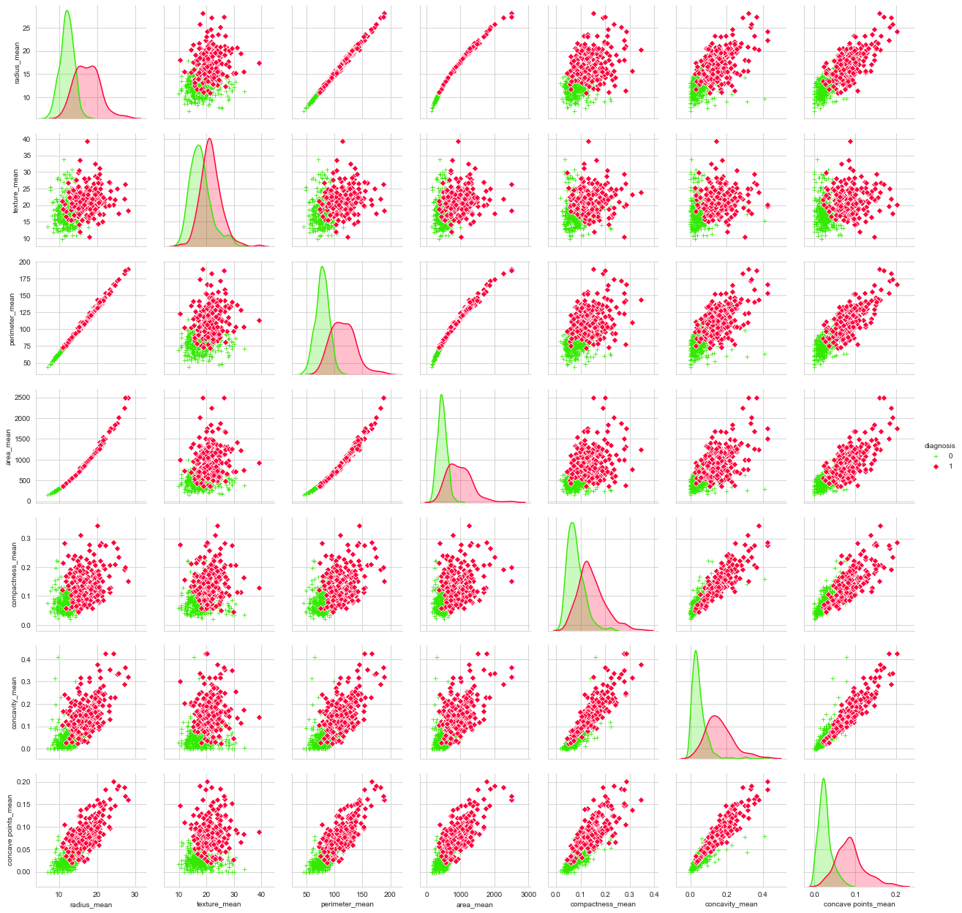

Slide 8
Correlation
Correlation with the target variable,
concave points_worst,
perimeter_worst,
concave points_mean, radius_worst

Slide 9
Correlation..cont’d
Most correlated features with each other:
radius_mean, perimeter_mean, area_mean, perimeter_worst, radius_worst, and area_worst
texture_mean , and texture_worst
area_se, perimeter_se, and radius_se
compactness_mean, compactness_worst, concavity_mean, concavity_worst, and concave points_worst.

Slide 10
Outlier Handling
Data values that are either less than the 2nd percentile or above the 98th percentile are removed from the dataset.
Out of the four outliers that we removed, two were malignant and the other two were benign.
Finally, after dropping and cleaning
565 observations and 31 columns.
4 outliers: 2 from each classes removed

Slide 11

Data Science for Accurate and Early Diagnosis
THANK YOU!!!

